Slide 1
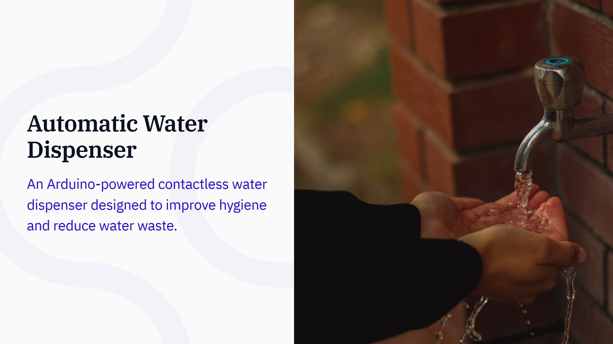

Slide 2
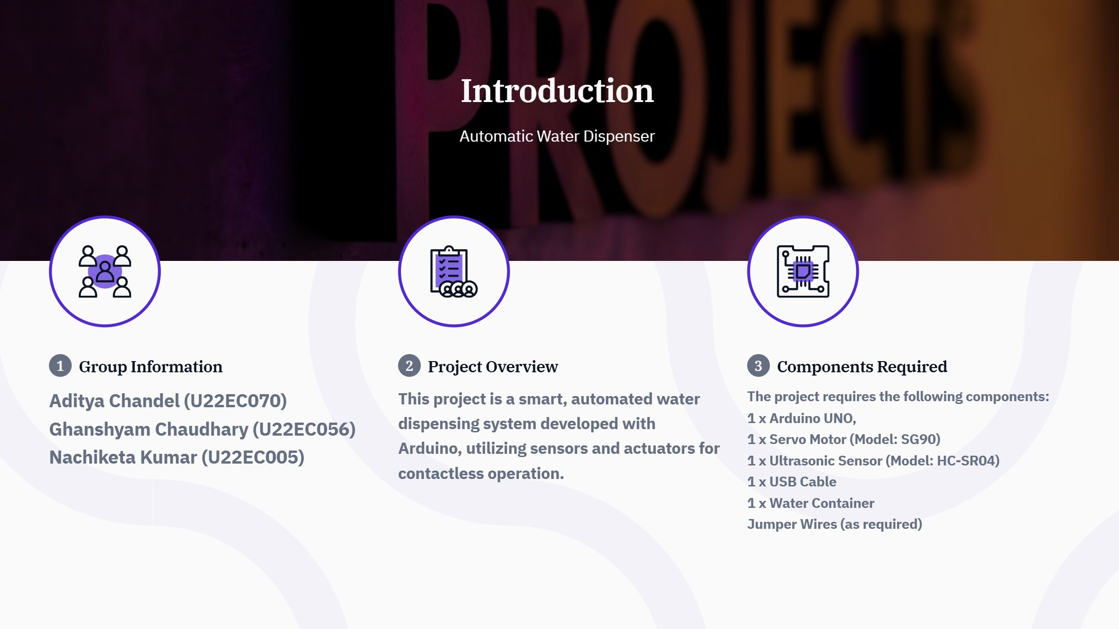

Slide 3
PROJECT DESCRIPTION
What It Is: A smart, Arduino-based system for hygienic and contactless water dispensing.
How It Works:
Detects a hand or glass using an ultrasonic sensor.
Activates a servo motor to control the tap automatically.
Key Features:
Minimizes contamination risks through touch-free operation.
Reduces water wastage with precise control.
Powered via USB for ease of use and portability.
Applications: Ideal for homes, offices, schools, and public spaces.

Slide 4
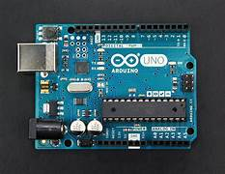
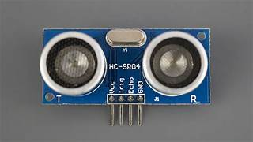
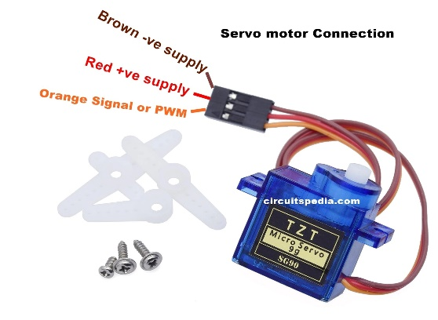
COMPONENTS USED
Arduino Uno
Ultrasonic Sensor
Servo Motor

Slide 5
Components Specifications
Arduino Uno
Ultrasonic Sensor
Servo Motor
Voltage: 5V DC
Range: 2 cm to 400 cm
Accuracy: ±0.3 cm
Frequency: 40 kHz
Angle: ~15°
Pins: VCC, Trig, Echo, GND
Function: Detects object distance
by emitting ultrasonic waves and
measuring the echo's return time.
Arduino UNO Features Used
Digital I/O Pins: Interface with
ultrasonic sensor and servo motor.
PWM Pins: Control servo motor for
tap operation.
USB: Used for programming and
powering the system.
Processing Power: Executes logic to
control dispensing based on sensor
input.
Arduino UNO serves as the central
controller for the project.
Servo Motor (SG90) Specifications
Operating Voltage: 4.8V to 6V
Torque: 1.8 kg·cm at 4.8V
Speed: 0.1 seconds/60° rotation at 4.8V
Rotation Angle: 0° to 180°
Weight: 9 grams
Dimensions: 22.2 mm × 11.8 mm × 31 mm
Control Signal: PWM (Pulse Width Modulation)
Function: The SG90 servo motor provides precise
angular movement, making it ideal for controlling
the tap mechanism in the Automatic Water
Dispenser.

Slide 6
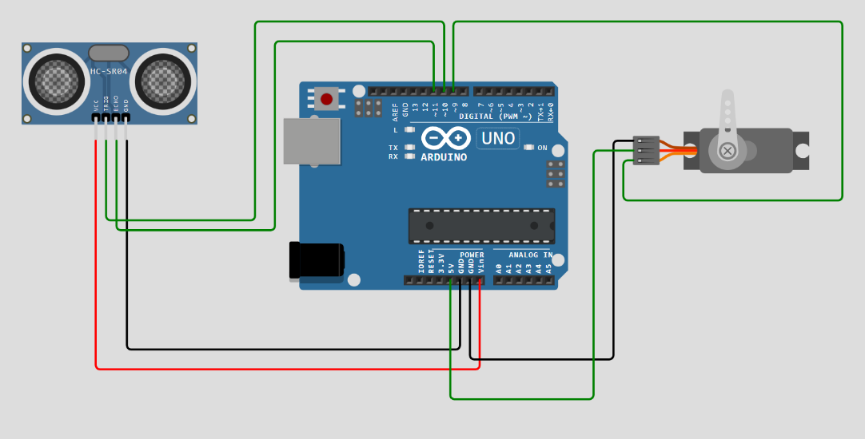
Electronic Schematic

Slide 7
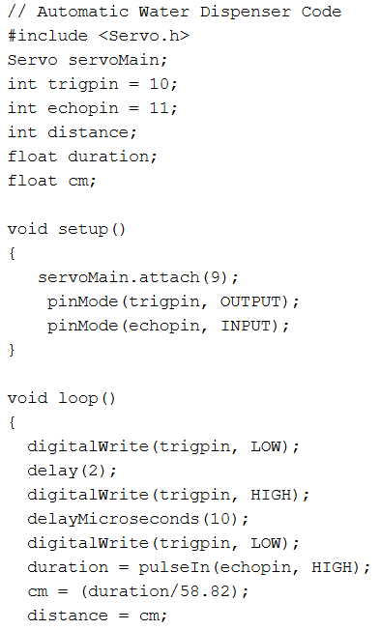
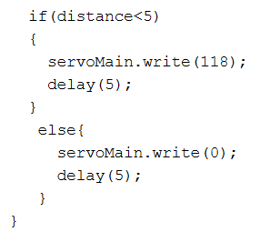
Arduino Program

Slide 8
Testing Video

Slide 9
FUTURE ADVANCEMENTS
Integration with Smart Technologies:
Integration with smart home systems (e.g., Alexa, Google Assistant) for remote control and monitoring.
Real-time water usage tracking and alerts via mobile apps or IoT platforms.
Sustainability Features:
Adding a water flow sensor to measure and optimize water dispensed, reducing wastage.
Solar-powered systems for off-grid operation, making the dispenser suitable for rural or remote areas.
AI and Machine Learning:
AI-driven optimization to predict water usage patterns and automate dispensing based on user habits.
Data analytics for efficient water consumption tracking and management, especially in high-traffic areas.
Multifunctional Applications:
Expand functionality to dispense other fluids such as hand sanitizers or soap in public spaces, improving hygiene in multiple areas.

Slide 10
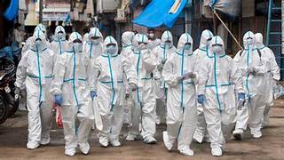
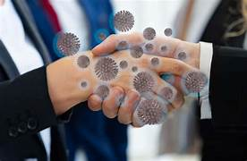
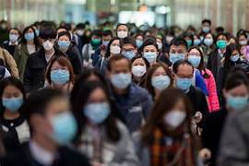
Global Vision
Promoting global hygiene:
Provide a cost-effective, contactless water dispensing solution for households, offices, schools, and public spaces worldwide, minimizing the risk of contamination.
Impact during global crises (e.g., COVID-19 pandemic):
During the COVID-19 crisis, touchless systems like this water dispenser became essential in reducing physical contact and preventing virus transmission in high-traffic areas.
Public spaces such as hospitals, offices, airports, and schools benefited from the dispenser by reducing the need for human interaction at water points, improving safety.
Sustainability and resource conservation:
Contribute to global water conservation by minimizing waste and improving the efficiency of water use.
Align with global sustainability goals, promoting eco-friendly practices in water usage.

Slide 11
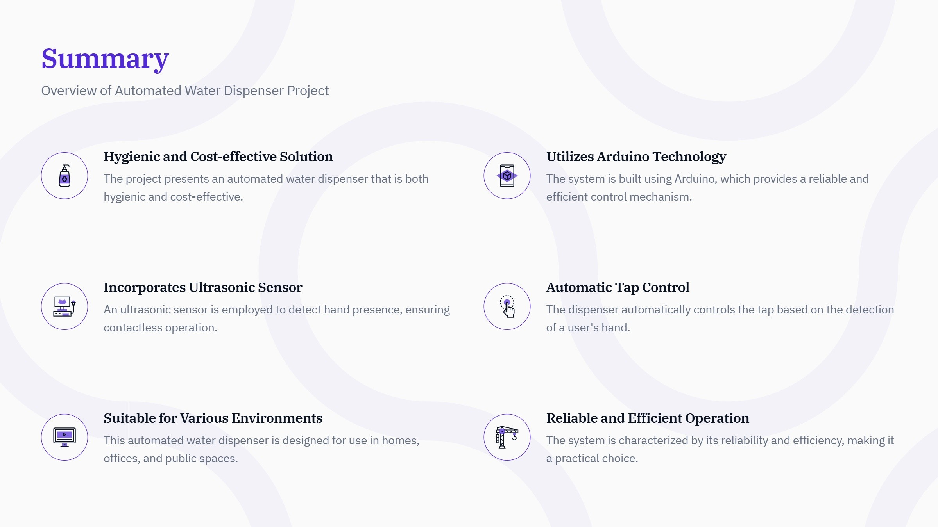

Slide 12
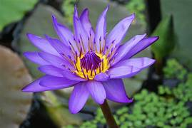
THANK YOU

